Slide 1
Inheritance in java

Slide 2
Types of Inheritance
Single Inheritance
Multilevel Inheritance
Hierarchical Inheritance
Multiple Inheritance
Hybrid Inheritance

Slide 3
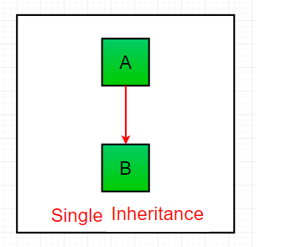
Single Inheritance

Slide 4
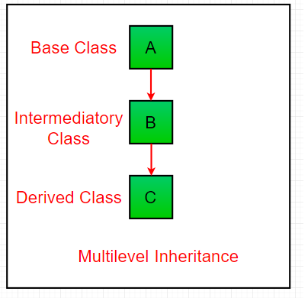
Multilevel Inheritance

Slide 5
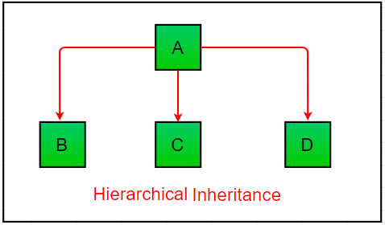
Hierarchical Inheritance

Slide 6
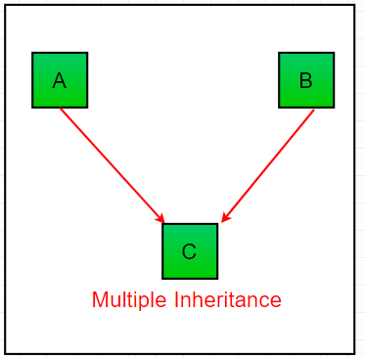
Multiple Inheritance

Slide 7
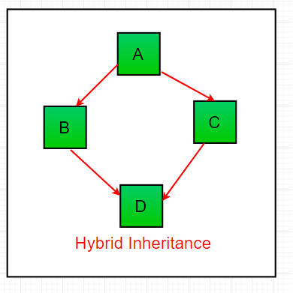
Hybrid Inheritance

